Slide 1
AirBnB Listings Portfolio Project
File created on: 10/26/2023 12:58:20 PM
By: Luis Navarro
Link: https://public.tableau.com/views/AirBnBListingsPortfolioProject/Dashboard1?:language=en-GB&publish=yes&:display_count=n&:origin=viz_share_link

Slide 2
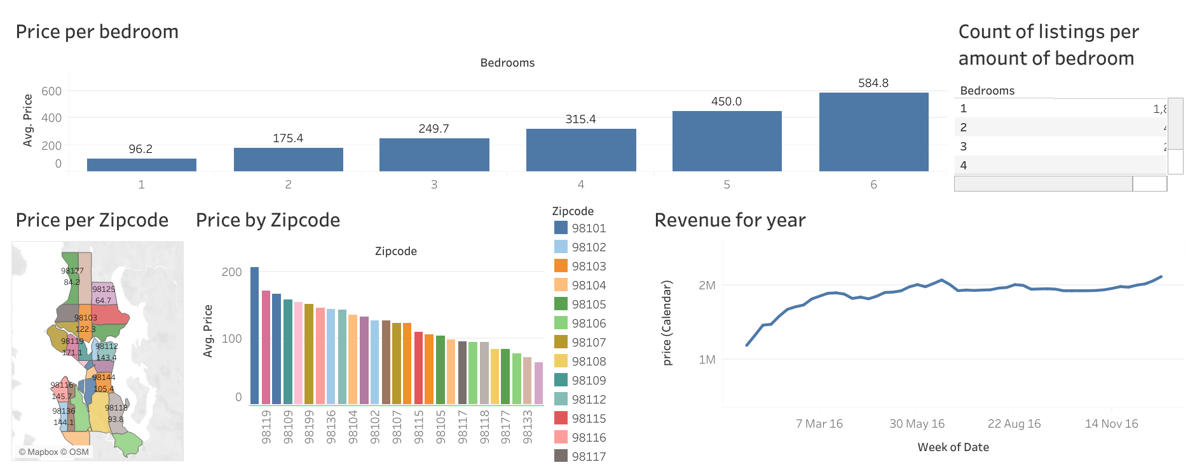
Data Analytics project.
Recommendation for a new AirBnB bussines

